Slide 1
AIM Challenge
Arabic Tweet Dialect
Mohamed Ahmed

Slide 2
Index
API request
Preprocessing
Dataset Visualization
CountVectorizer & TFIDFVectorizer
Word tokenizer & padding sequences
Pipeline and test split
Tune Hyperparameters with GridSearchCV
SGD Classifier
SVM Classifier

Slide 3
Index
Word embedding's
Bi-LSTM With Attention
RNN
LSTM
Bi-LSTM
Attention Layer
Bert
Run Code
Flask APP
Notes

Slide 4
API request
Looping over the csv file and catching over each 1000 text on each request
Saving the text with Dialect in another csv file for the preprocessing phase

Slide 5
Preprocessing
As we are trying to find some patterns that represent each Dialect we don’t need to use lemmatization and stemming process some additions character or some words can represent dialect and some words has no source
So preprocessing will follow this steps
Remove emoji
Remove email
Remove accounts tag
Remove hashtag
Remove links
Remove less 2 characters
Remove repeated char
Remove punctuation
Remove tashkeel
Remove spaces
Remove stop_words
Will keep Latin characters for franko represntations

Slide 6

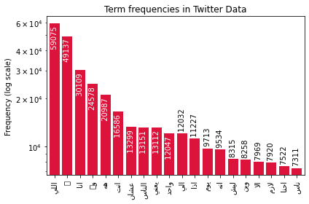
Dataset Visualization
Most Frequency word

Slide 7
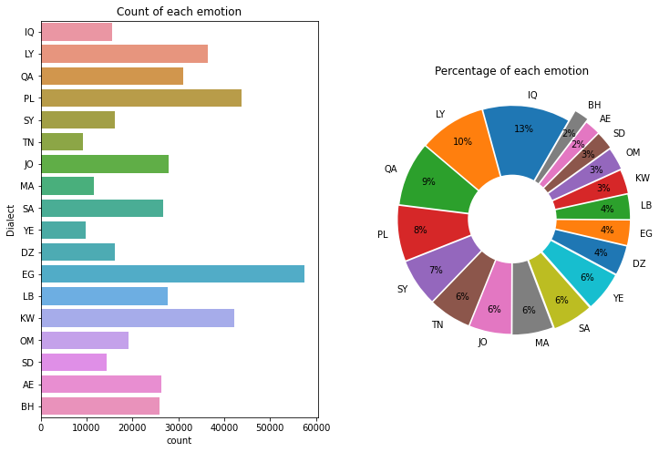
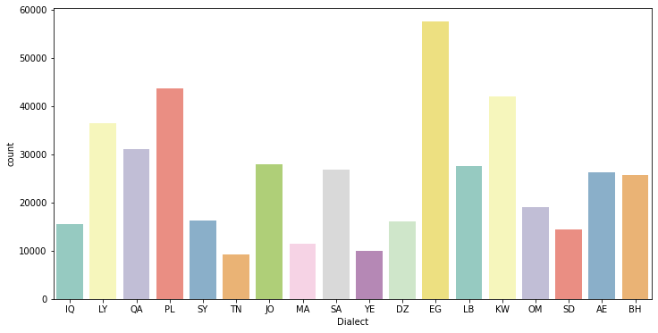
Dataset Visualization
Classes Distribution

Slide 8
CountVectorizer & TFIDFVectorizer
CountVectorizer:-
Counts the frequency of all words in our corpus, sorts them and grabs the most recurring features (using max_features hyperparameter). But these results are mostly biased and our model might loose out on some of the important less frequent features. These are all boolean values. Ex. SEO People used to take advantage of this.
TFIDFVectorizer:-
TFIDF is a statistical measure said to have fixed the issues with CountVectorizer in some way. It consists of 2 parts, TF (Term Frequency) multiplied with IDF (Inverse Document Frequency). The main intuition being some words that appear frequently in 1 document and less frequently in other documents could be considered as providing extra insight for that 1 document and could help our model learn from this additional piece of information. In short, common words are penalized. These are relative frequencies identified as floating point numbers.

Slide 9
Word tokenizer & padding sequences
Tokenization
is one of the most common tasks when it comes to working with text data, Tokenization is essentially splitting a phrase, sentence, paragraph, or an entire text document into smaller units, such as individual words or terms. Each of these smaller units are called tokens.
Padding sequences
Used to ensure that all sequences in a list have the same length. By default this is done by padding 0 in the beginning of each sequence until each sequence has the same length as the longest sequence longest sequence will be (61) is the longest splitted statement form saved csv file.

Slide 10
Pipeline and test split
Train test split:-
Data will be splitted 0.06 for test and rest for train with stratify option
Pipeline:-
CountVectorizer and TFIDFVectorizer:-
will be saved in one single pipeline as pkl file
Tokenizater:-
will be saved in one single pipeline as pkl file
Label encoder:-
Representation for each class as a single unique number, will be saved in one single pipeline as pkl file
Model parameters:-
Vocab size, max sentence length, number of classes all will be in a dictionary format will be saved in json file

Slide 11
Tune Hyperparameters with GridSearchCV
Grid Search, cross-validation is also performed. Cross-Validation is used while training the model. As we know that before training the model with data, we divide the data into two parts – train data and test data. In cross-validation, the process divides the train data further into two parts – the train data and the validation data.
The most popular type of Cross-validation is K-fold Cross-Validation.
It is an iterative process that divides the train data into k partitions. Each iteration keeps one partition for testing and the remaining k-1 partitions for training the model. The next iteration will set the next partition as test data and the remaining k-1 as train data and so on.
In each iteration, it will record the performance of the model and at the end give the average of all the performance. Thus, it is also a time-consuming process.
Thus, GridSearch along with cross-validation takes huge time cumulatively to evaluate the best hyperparameters.
GridSearchCV can be used on several hyperparameters to get the best values for the specified hyperparameters.
Estimator:- the model
param_grid:- A dictionary with parameter names as keys and lists of parameter values.
Scoring:- The performance measure. For example, ‘r2’ for regression models, ‘precision’ for classification models.
Cv:- An integer that is the number of folds for K-fold cross-validation.

Slide 12
SGD Classifier
SGD Classifier one vs all estimator, implements regularised linear models with Stochastic Gradient Descent.
SGD is a This estimator implements regularized linear models with stochastic gradient descent (SGD) learning: the gradient of the loss is estimated each sample at a time and the model is updated along the way with a decreasing strength schedule (aka learning rate). SGD allows minibatch (online/out-of-core) learning, see the partial_fit method. For best results using the default learning rate schedule, the data should have zero mean and unit variance.
This implementation works with data represented as dense or sparse arrays of floating point values for the features. The model it fits can be controlled with the loss parameter; by default, it fits a linear support vector machine (SVM).
The regularizer is a penalty added to the loss function that shrinks model parameters towards the zero vector using either the squared euclidean norm L2 or the absolute norm L1 or a combination of both (Elastic Net). If the parameter update crosses the 0.0 value because of the regularizer, the update is truncated to 0.0 to allow for learning sparse models and achieve online feature selection.
penalty:-
'none', 'l2', 'l1', or 'elasticnet, The penalty (aka regularization term) to be used. Defaults to 'l2' which is the standard regularizer for linear SVM models. 'l1' and 'elasticnet' might bring sparsity to the model (feature selection) not achievable with 'l2'.
alpha:-
Constant that multiplies the regularization term. Defaults to 0.0001 Also used to compute learning_rate when set to 'optimal'.
max_iter:-
The max number of epochs over the training data

Slide 13
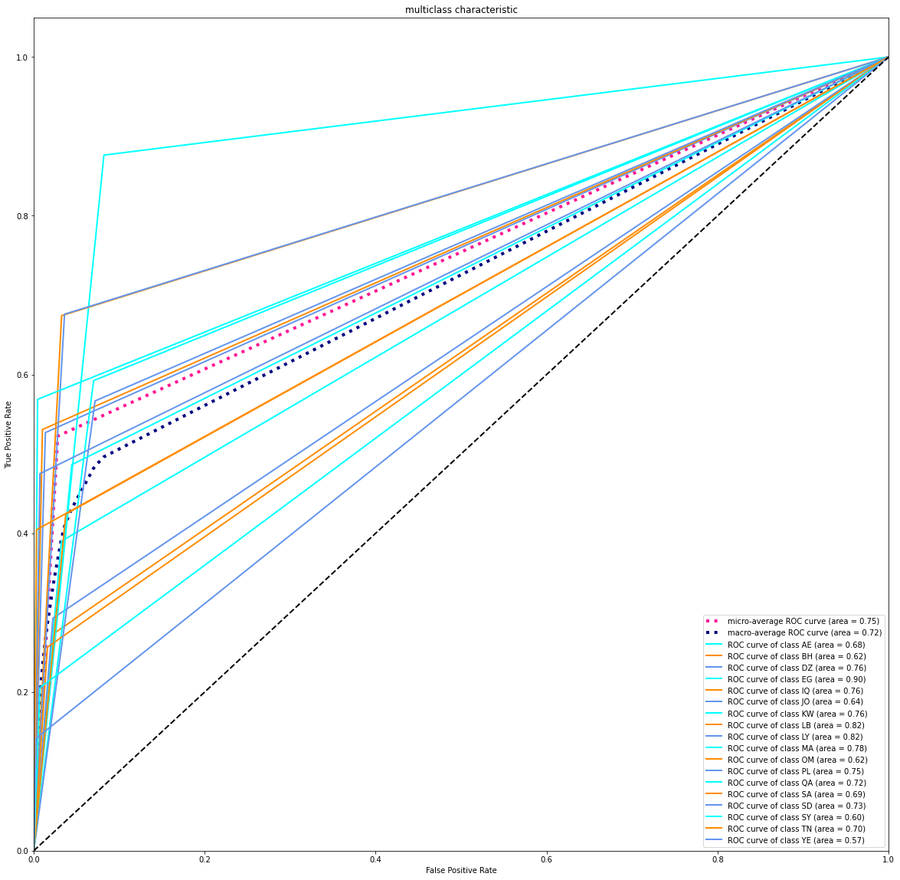
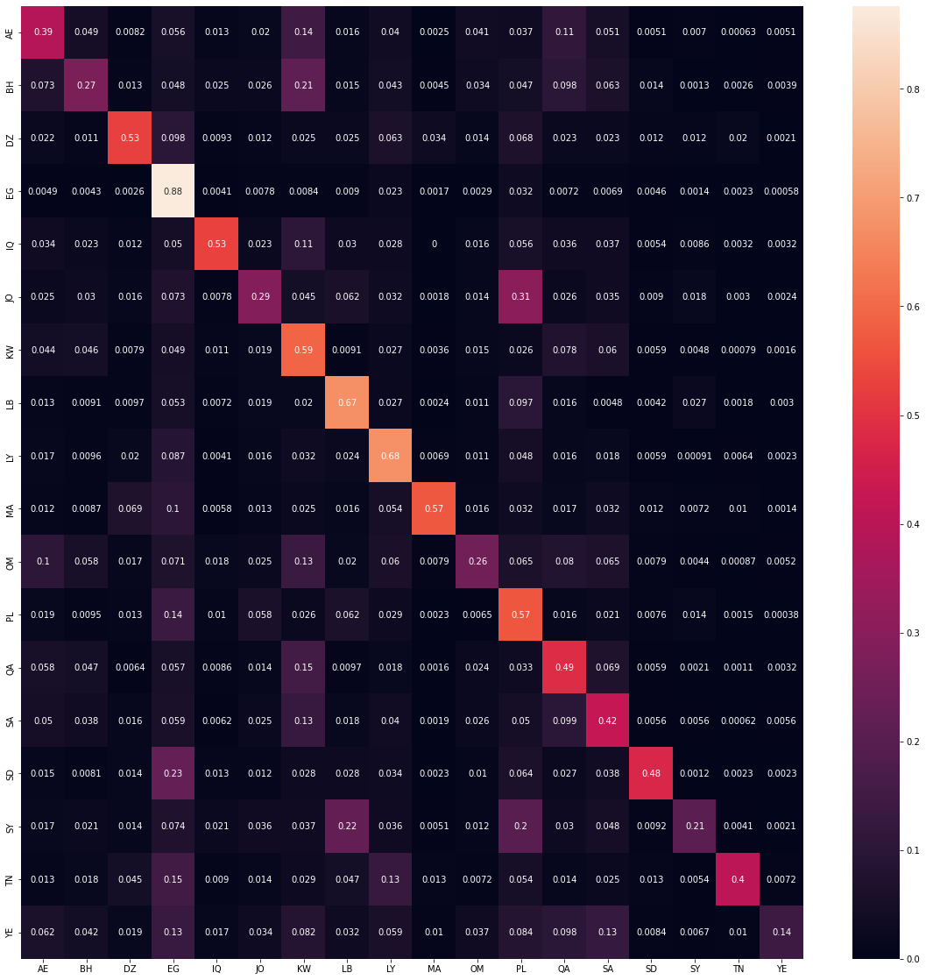
SGD Results
Results on Testset

Slide 14
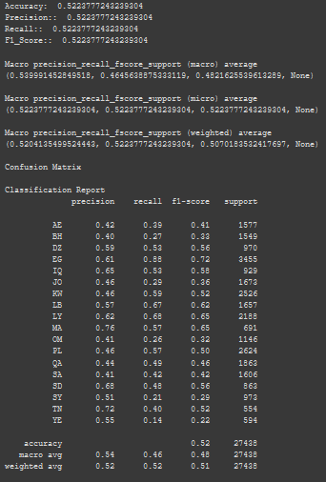
SGD Results
Results on Testset

Slide 15
SVM Classifier
The objective of the support vector machine algorithm is to find a hyperplane in an N-dimensional space(N the number of features) that distinctly classifies the data points
To separate the two classes of data points, there are many possible hyperplanes that could be chosen. Our objective is to find a plane that has the maximum margin, i.e the maximum distance between data points of both classes. Maximizing the margin distance provides some reinforcement so that future data points can be classified with more confidence.
Hyperplanes are decision boundaries that help classify the data points. Data points falling on either side of the hyperplane can be attributed to different classes.
The C parameter tells the SVM optimization how much you want to avoid misclassifying each training example. For large values of C, the optimization will choose a smaller-margin hyperplane if that hyperplane does a better job of getting all the training points classified correctly. Conversely, a very small value of C will cause the optimizer to look for a larger-margin separating hyperplane, even if that hyperplane misclassifies more points. For very tiny values of C, you should get misclassified examples, often even if your training data is linearly separable.
C:-
Penalty parameter C of the error term.
kernel:-
Specifies the kernel type to be used in the algorithm. It must be one of 'linear', 'poly', 'rbf', 'sigmoid', 'precomputed' or a callable. If none is given, 'rbf' will be used. If a callable is given it is used to pre-compute the kernel matrix from data matrices; that matrix should be an array of shape (n_samples, n_samples).
degree:-
Degree of the polynomial kernel function ('poly'). Ignored by all other kernels.

Slide 16
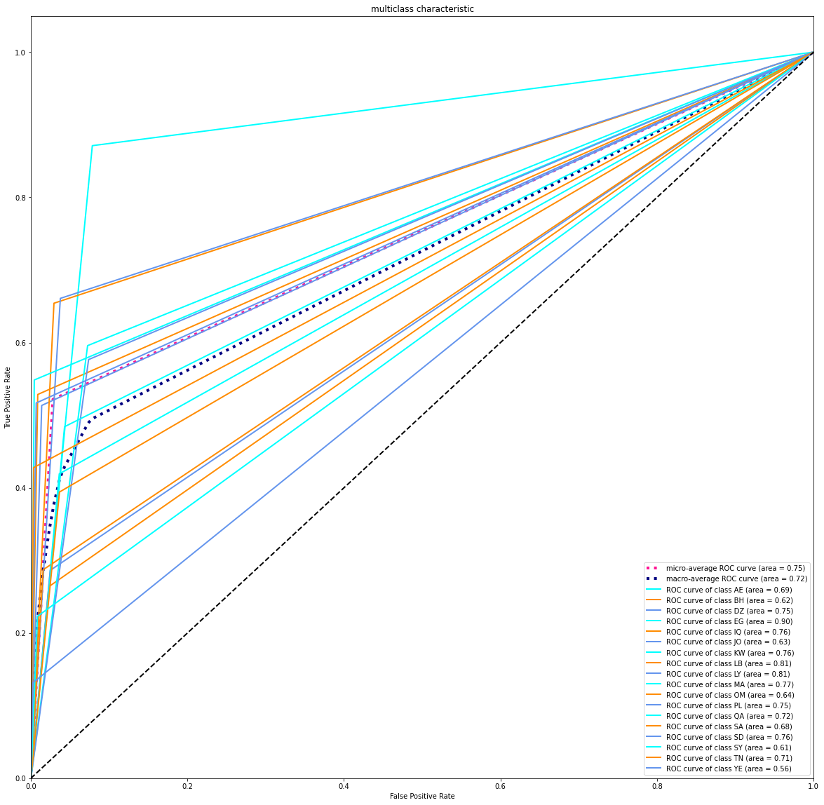
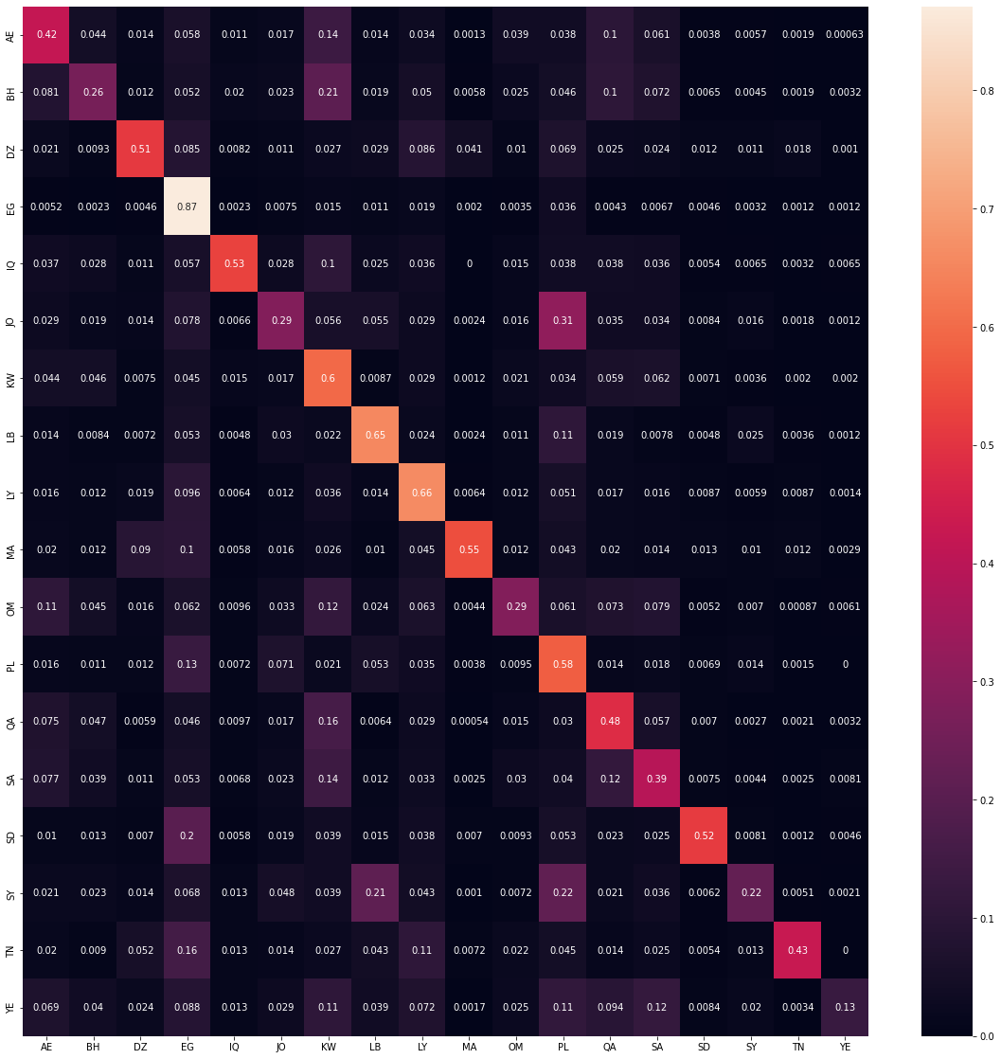
SVM Results
Results on Testset

Slide 17
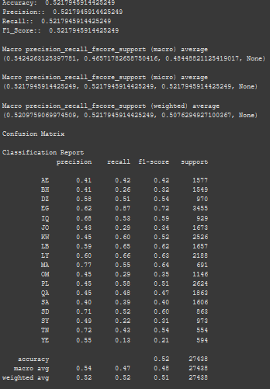
SVM Results
Results on Testset

Slide 18
Word embedding's
Word embeddings can be thought of as an alternate to one-hot encoding along with dimensionality reduction.
As we know while dealing with textual data, we need to convert it into numbers before feeding into any machine learning model, including neural networks. For simplicity words can be compared to categorical variables. We use one-hot encoding to convert categorical features into numbers. To do so, we create dummy features for each of the category and populate them with 0’s and 1's.
Similarly if we use one-hot encoding on words in textual data, we will have a dummy feature for each word, which means 10,000 features for a vocabulary of 10,000 words. This is not a feasible embedding approach as it demands large storage space for the word vectors and reduces model efficiency.
Embedding layer enables us to convert each word into a fixed length vector of defined size. The resultant vector is a dense one with having real values instead of just 0’s and 1’s. The fixed length of word vectors helps us to represent words in a better way along with reduced dimensions.

Slide 19
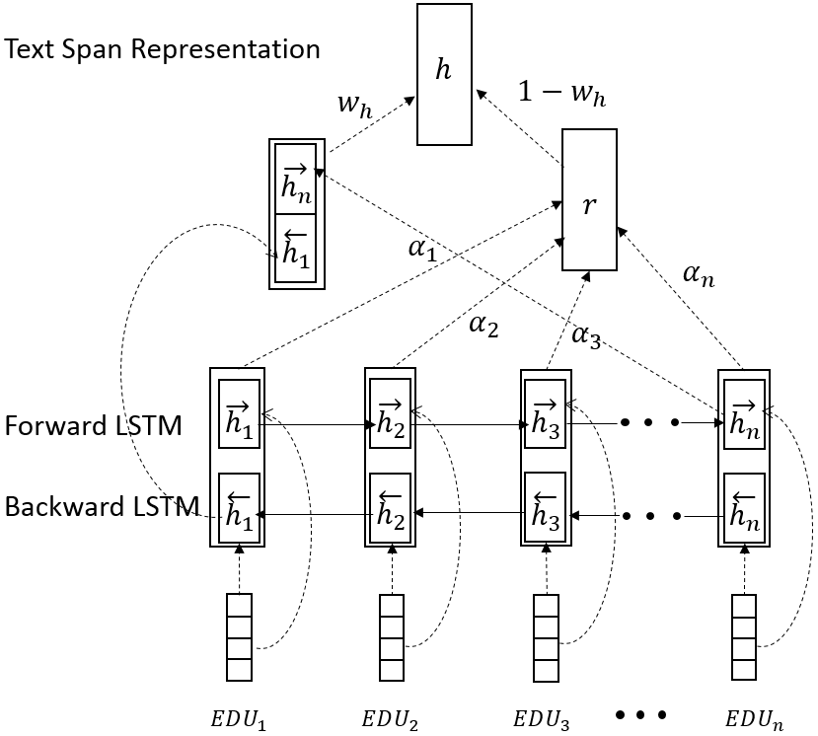
Bi-LSTM With Attention

Slide 20
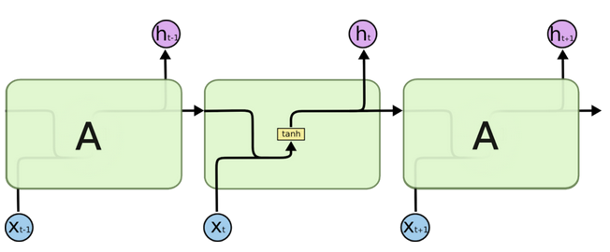
RNN
RNN(recurrent neural network) is a type of neural network that we use to develop speech recognition and natural language processing models. Recurrent neural networks remember the sequence of the data and use data patterns to give the prediction.
RNN uses feedback loops which makes it different from other neural networks. Those loops help RNN to process the sequence of the data. This loop allows the data to be shared to different nodes and predictions according to the gathered information. This process can be called memory.
RNN and the loops create the networks that allow RNN to share information, and also, the loop structure allows the neural network to take the sequence of input data. RNN converts an independent variable to a dependent variable for its next layer.
.
.
.
.

Slide 21
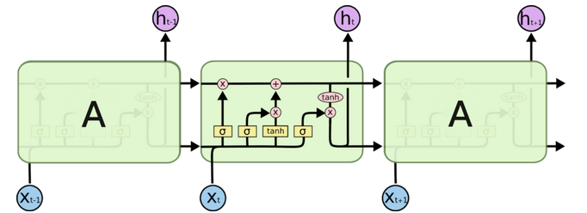
LSTM
Long short term memory networks, usually called LSTM – are a special kind of RNN. They were introduced to avoid the long-term dependency problem. In regular RNN, the problem frequently occurs when connecting previous information to new information. If RNN could do this, they’d be very useful. This problem is called long-term dependency.
To remember the information for long periods in the default behaviour of the LSTM. LSTM networks have a similar structure to the RNN, but the memory module or repeating module has a different LSTM. The block diagram of the repeating module will look like the image below.
.
.
.
.
.

Slide 22
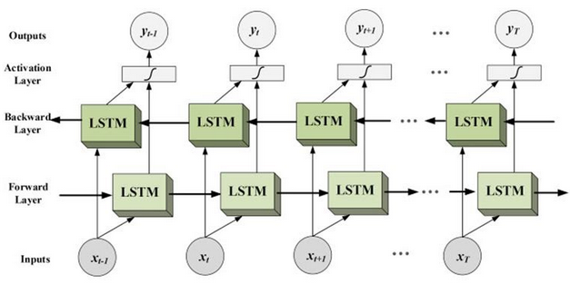
Bi-LSTM
Bidirectional long-short term memory(bi-lstm) is the process of making any neural network o have the sequence information in both directions backwards (future to past) or forward(past to future).
In bidirectional, our input flows in two directions, making a bi-lstm different from the regular LSTM. With the regular LSTM, we can make input flow in one direction, either backwards or forward. However, in bi-directional, we can make the input flow in both directions to preserve the future and the past information.
.
.
.
.
.

Slide 23
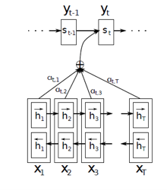
Attention Layer
A mechanism that can help a neural network to memorize long sequences of the information or data can be considered as the attention mechanism and broadly it is used in the case of Neural machine translation(NMT). As we have discussed in the above section, the encoder compresses the sequential input and processes the input in the form of a context vector. We can introduce an attention mechanism to create a shortcut between the entire input and the context vector where the weights of the shortcut connection can be changeable for every output.
Because of the connection between input and context vector, the context vector can have access to the entire input, and the problem of forgetting long sequences can be resolved to an extent. Using the attention mechanism in a network, a context vector can have the following information:
Encoder hidden states;
Decoder hidden states;
Alignment between source and target.

Slide 24
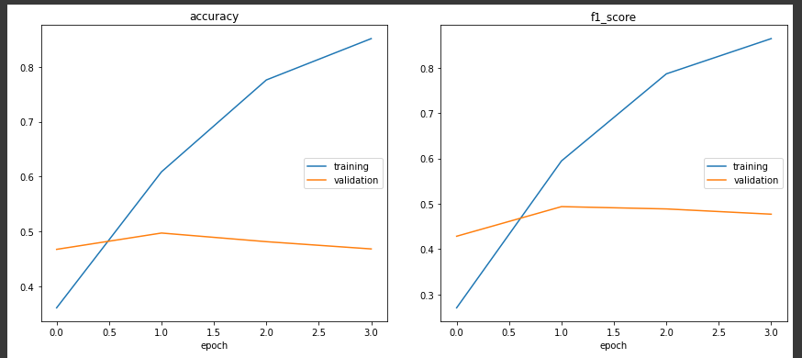
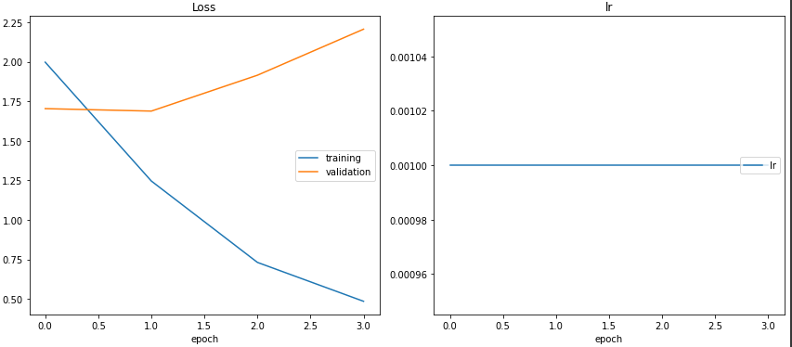
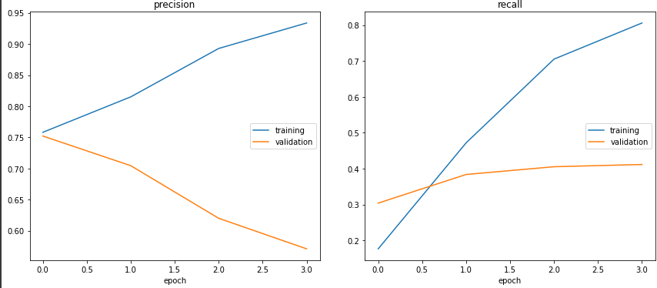
BI-LSTM-Attention Results

Slide 25
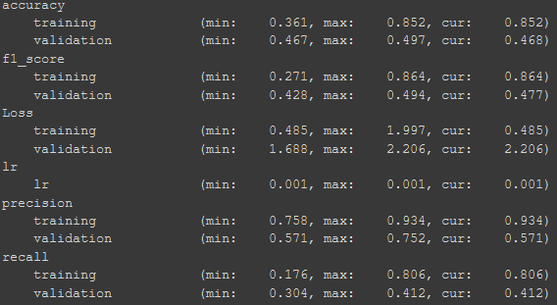
BI-LSTM-Attention Results
Early stop to prevent overfitting

Slide 26
Bert
BERT is an open source machine learning framework for natural language processing (NLP). BERT is designed to help computers understand the meaning of ambiguous language in text by using surrounding text to establish context.
BERT, which stands for Bidirectional Encoder Representations from Transformers, is based on Transformers, a deep learning model in which every output element is connected to every input element, and the weightings between them are dynamically calculated based upon their connection. (In NLP, this process is called attention.)
Using this bidirectional capability, BERT is pre-trained on two different, but related, NLP tasks: Masked Language Modeling and Next Sentence Prediction.
The goal of any given NLP technique is to understand human language as it is spoken naturally. In BERT's case, this typically means predicting a word in a blank. To do this, models typically need to train using a large repository of specialized, labeled training data. This necessitates laborious manual data labeling by teams of linguists.

Slide 27
Bert
BERT, however, was pre-trained using only an unlabeled, plain text corpus (namely the entirety of the English Wikipedia, and the Brown Corpus). It continues to learn unsupervised from the unlabeled text and improve even as its being used in practical applications (ie Google search). Its pre-training serves as a base layer of "knowledge" to build from. From there, BERT can adapt to the ever-growing body of searchable content and queries and be fine-tuned to a user's specifications. This process is known as transfer learning.
As mentioned above, BERT is made possible by Google's research on Transformers. The transformer is the part of the model that gives BERT its increased capacity for understanding context and ambiguity in language. The transformer does this by processing any given word in relation to all other words in a sentence, rather than processing them one at a time. By looking at all surrounding words, the Transformer allows the BERT model to understand the full context of the word, and therefore better understand searcher intent.
This is contrasted against the traditional method of language processing, known as word embedding, in which previous models like GloVe and word2vec would map every single word to a vector, which represents only one dimension, a sliver, of that word's meaning.
These word embedding models require large datasets of labeled data. While they are adept at many general NLP tasks, they fail at the context-heavy, predictive nature of question answering, because all words are in some sense fixed to a vector or meaning. BERT uses a method of masked language modeling to keep the word in focus from "seeing itself" -- that is, having a fixed meaning independent of its context. BERT is then forced to identify the masked word based on context alone. In BERT words are defined by their surroundings, not by a pre-fixed identity. In the words of English linguist John Rupert Firth, "You shall know a word by the company it keeps.“

Slide 28
Run Code
There are 4 main:-
Main:- for run app flask load all model and pre processing pkl to run the flask app
Main1:- to request and visualize dataset
Preprocessing:-
Label encoder
CountVectorizer & TFIDFVectorizer
Build and Train SGD, SVM Classifier
Test SGD, SVM Classifier & Evaluate model
Main2:-
Preprocessing:-
Word tokenizer
Padding sequences
Build Bi-LSTM-Attention
Train Bi-LSTM-Attention
Test Bi-LSTM-Attention Model & Evaluate

Slide 29
Run Code
Main3:-
Preprocessing:-
Build Bert Tokenizer
Build & Train Basic Bert Model
Test Basic Bert Model & Evaluate
For Arabert there is a notebook for it code is running fine but take much time to complete
For each of this main there is a single one for it to train and produce the training weights

Slide 30
Flask App
The flask web page is simple just enter the text, select the model and press classify
Each model from previous slides has it’s own pipline
SGD classifier:-
Preprocsssing, Countvectorizer, TDF vectorizer
SVM classifier:-
Preprocsssing, Countvectorizer, TDF vectorizer
Bi-LSTM- attention classifier:-
Preprocsssing, Tokenizer, padding sequences
Bert has it’s own tokenizer techniques using mask index, but preprocessing step still same

Slide 31
Notes
SGD model pkl (500 MB) was removed to reduce the size for uploading.
SVM model pkl (500 MB)was removed to reduce the size for uploading.
Preprocessing Pipline pkl (200 MB) was removed to reduce the size for uploading.
Bi-lstm-attention model weights h5 (190 MB) Was removed to reduce the size for uploading.
Bert model weights h5 (900 MB) Was removed to reduce the size for uploading.
Arabbert need 27h for one epoch to finish but it’s work fine, 5 hours of training with no issues, you could try it too.
All you need to run each main(1,2,3) to produce model weights (pkl, h5)

Slide 32
GITHUB LINK

